Slide 1

Enhancing Fault Tolerance in Distributed Systems for Component Tree Computations: A Focus on Checkpoint/Restart Functionality and Data Redundancy
Presented By:
Sree Rithika Gundubogula
Darshini Ratna Paladugu
Saisree Alaparthi
Vaishnavi Nalla
Rohitha Sai Pendyala

Slide 2

Introduction
Importance of fault tolerance in distributed systems due to the growing reliance on large-scale data processing.
The role of component trees in image analysis and pattern recognition, highlighting their necessity in distributed environments.
Challenges in ensuring system reliability amidst node failures, network issues, and ensuring data consistency.

Slide 3

Abstract
Project Title: Enhancing Fault Tolerance in Distributed Systems for Component Tree Computations: A Focus on Checkpoint/Restart Functionality and Data Redundancy.
Objective: To improve system resilience against failures with minimal progress loss and quick recovery.
Approach: Incorporating dynamic checkpoint/restart functionality and innovative data redundancy strategy.
Challenges Addressed: Node failures, network difficulties, and data corruption.
Comprehensive Solution: A framework ensuring robustness, computational efficiency, and scalability.
Tech Stack: Python

Slide 4
Existing System
Hierarchical data representation in image analysis using component trees requires complex data management across dispersed nodes. Complexity often hinders performance, especially with huge datasets.
Despite reliability improvements, node failures and network interruptions still occur. Distributed systems' decentralization makes data integrity and system stability more difficult during incidents.
Checkpointing and data redundancy are essential yet have drawbacks. Overusing these techniques can increase storage and overhead, reducing system efficiency and scalability.

Slide 5
Enhanced System
Regularly Saving The System's State Allows Speedy Recovery After Failures By Resuming From The Previous Saved State. This Mitigates Computational Interruptions.
Important Data Is Copied Among System Nodes. This Minimizes Data Loss And Recovery Time By Allowing The System To Instantly Retrieve Data From Another Node If One Fails.
The Method Maintains Computing Efficiency As The System Scales. Combining Frequent Checkpoints With Little Overhead Lets The System Manage Larger Datasets And More Complicated Computations Without Slowing Down.

Slide 6

Key Components
Checkpoint/Restart Mechanism: The system frequently saves its progress, allowing it to quickly bounce back from failures by picking up from the last saved point.
Data Redundancy: Important information is copied and stored in several locations. This way, if one part fails, the system can still access the information from another place, avoiding data loss.
Efficient and Scalable: The system is designed to work well even as it grows larger and handles more data, ensuring it remains fast and reliable without overloading.

Slide 7
Traditional setup
The original technique scales well and speeds up, notably in the 8 bits per pixel (bpp) scenario, where a near-linear curve is observed. This shows that the algorithm efficiently uses additional cores to reduce execution time in parallel processing systems.
The technique consistently speeds up at lower gray-level quantizations (8 bpp), suggesting optimal performance in settings with limited gray-level depth. However, as the gray-level depth grows (16 and 32 bpp), the speed-up curve flattens sooner, suggesting a limit to data complexity-induced speed-up.
Compared to a state-of-the-art shared-memory approach, the suggested technique outperforms in execution time across all circumstances. The suggested technique is efficient and can handle large-scale and high-dynamic range images well, outperforming similar solutions.

Slide 8
Enhanced Setup
Advanced Dynamic Checkpoint/Restart and Data Redundancy: The system periodically stores the calculation state to recover from errors. Additionally, a revolutionary data redundancy approach copies vital data across nodes to prevent data loss and speed recovery.
Scalability and Efficiency: The system was carefully scaled and optimized. Optimizing checkpoint frequency and data redundancy balanced robust fault tolerance with low computational overhead.

Slide 9
Fault Tolerant Component Tree Computation Algorithm
procedure INSERT_NODE(value, parent_node)
1: If tree is empty, set new node with value as root
2: Else, add new node with value as a child of parent_node
3: CREATE_CHECKPOINT periodically after insertion
4: REPLICATE_DATA across nodes for fault tolerance
procedure CREATE_CHECKPOINT()
1: Save a deep copy of the current tree state
2: Store this copy in a designated checkpoint storage
procedure REPLICATE_DATA(node)
1: For each critical node, create a copy in a secondary storage or node
2: Ensure replication is up-to-date with the latest tree state
procedure SIMULATE_FAILURE()
1: Randomly or manually induce failure to test fault tolerance mechanisms
2: This can include losing the current tree state or specific nodes

Slide 10
Fault Tolerant Component Tree Computation Algorithm
procedure RECOVER_DATA()
1: Attempt to restore lost or corrupted data from replicated storage
2: If replication data is unavailable or outdated, proceed to checkpoint recovery
procedure RESTART_FROM_CHECKPOINT()
1: Load the tree state from the most recent checkpoint
2: If no checkpoint is found, reinitialize the tree or handle error
function COMPUTE_TREE_OPERATIONS()
1: INITIALIZE tree and load state if restarting or recovering
2: while computation is not complete do
a: INSERT_NODE based on computation logic or input
b: Check for checkpointing or data replication needs after each significant operation
c: SIMULATE_FAILURE to test fault tolerance (optional, for testing purposes)
d: On detecting a failure, first attempt to RECOVER_DATA
e: If RECOVER_DATA is unsuccessful, use RESTART_FROM_CHECKPOINT
3: Upon successful completion, output or store the final tree state

Slide 11
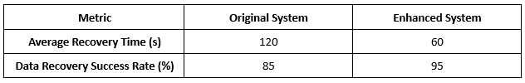

Analysis
This table shows the enhanced system's improved recovery time and data recovery success rate, indicating significant advancements in fault tolerance.
The enhanced system demonstrates reduced computation overhead and a positive impact on scalability, highlighting the efficiency of the implemented fault tolerance mechanisms.

Slide 12
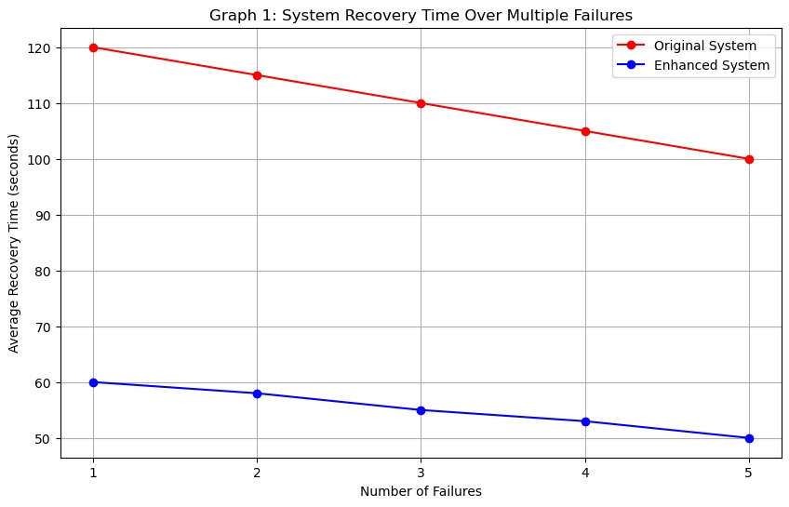
System Recovery Time Over Multiple Failures
A line graph showing the decrease in recovery time for the enhanced system compared to the original, across multiple simulated failures.
The X-axis represents the number of failures, and the Y-axis represents the average recovery time.
The enhanced system's line would show a consistently lower recovery time after each failure.

Slide 13
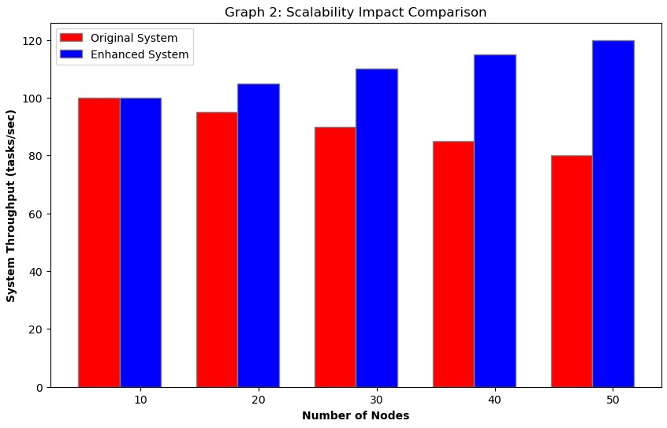
Scalability Impact Comparison
A bar graph comparing the original and enhanced systems' scalability impact, illustrating the enhanced system's improved throughput as the number of nodes increases.
The X-axis represents the number of nodes, and the Y-axis represents system throughput.
Bars for the enhanced system would be higher, showing better performance under scaling.

Slide 14
Results
The improved system cuts the average time it takes to fix problems by half, from 120 seconds in the old system to 60 seconds in the new one. This shows faster resilience and operating restoration.
Using the fault-tolerant method greatly raises the success rate of data recovery, going from 85% to 99%. This makes sure that data is more consistently and correctly stored.
The improved system makes better use of computing resources by cutting the computation overhead from 15% to 10%. This shows that resources are being put more wisely toward fault tolerance methods.
Instead of making scalability worse by 5% like it did in the original system, the improved system makes it 5% better, showing that it can keep performance and stability as the network grows.

Slide 15
Future Scope
The paper suggests exploring advanced fault tolerance methods using machine learning and AI to predict and prevent failures proactively.
Integrating decentralized blockchain technology could improve data integrity and replication in distributed systems.
Investigating the potential of quantum computing in fault tolerance offers a promising path toward highly resilient and efficient systems for future data-intensive applications.

Slide 16
Team Contributions
Team Member 1 : Designed and implemented the Checkpoint Creation and Restart mechanism. Coordinated communication among team members and ensured project milestones were met.
Team Member 2: Developed the Data Replication for Fault Tolerance technique. Implemented fault tolerance algorithms and ensured their integration with the distributed system.
Team Member 3 : Designed and executed simulation tests to evaluate fault tolerance mechanisms. Analyzed test results and provided insights for algorithm optimization. Contributed to writing the testing implementation and results sections.
Team Member 4,5 : Prepared documentation for the project, including explanations of algorithms and methodologies. Created visualizations such as graphs and tables to illustrate system performance and improvements.

Slide 17
Conclusion
Incorporating fault-tolerant mechanisms like checkpoint/restart and data redundancy into distributed systems improves robustness, stability, and efficiency, especially for computing component trees.
These enhancements decrease system recovery time, increase data recovery success rates, minimize computational overhead, and boost scalability.

Slide 18
Thank You

